Slide 1
Together towards a sustainable world and healthier living Corporate Presentation

Slide 2
Together towards a sustainable world and healthier living Corporate Presentation

Slide 3
Together towards a sustainable world and healthier living Corporate Presentation

Slide 4
Together towards a sustainable world and healthier living Corporate Presentation

Slide 5
Together towards a sustainable world and healthier living Corporate Presentation

Slide 6
Together towards a sustainable world and healthier living Corporate Presentation

Slide 7
Together towards a sustainable world and healthier living Corporate Presentation

Slide 8
Together towards a sustainable world and healthier living Corporate Presentation

Slide 9
Diversified and multinational: key facts about SARIA
Industries served
locations
worldwide
200+
countries
26
food
feed
pet food
continents
6
head office
Selm
Germany
Company profile
pharma
fuel
agriculture
years in
business
50+
employees
internationally
13,000
energy
technical
oleochemistry
2022
revenue*
family-
owned
100%
€ 3.7
bn
*not including Devro due to completion of transaction in 2023

Slide 10
A family business: SARIA is part of the RETHMANN Group
34 %
Sustainable solutions, products and services
Recycling, services and water
All-round logistics services
Local public transport services
13,000 employees
€ 3.7 bn*
42,000 employees
€ 12.1 bn
39,000 employees
€ 8.8 bn
103,600 employees
€ 9.3 bn
Revenues are the consolidated figures for FY2022.
*not including Devro due to completion of transaction in 2023

Slide 11
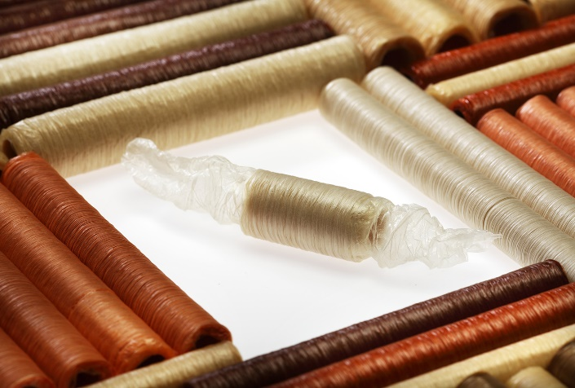
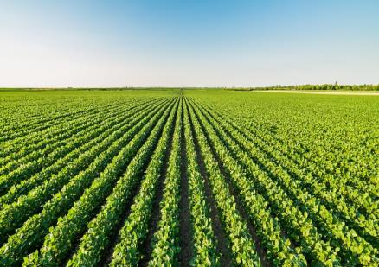
Our portfolio: reliable services and sustainable products
Feed for aquaculture
Animal feed
Collagen films and coatings
Biofuel
Services for the food industry
Pet food
Natural casings
Organic fertilizer
Services for the agricultural sector
Supplements for animal health
Renewable energy
Pharmaceutical ingredients
SARIA Corporate Video
Heparin API

Slide 12
Successful development: sustainable growth for many years
Continuous expansion of our portfolio through new applications, technologies, and solutions
Increased specialization and upscaling in the products and services we offer
Internationalization in relevant growth markets with a global perspective
Clear customer focus and sustainability as the basis for future growth
The Group’s revenue grows to EUR 3 bn
The Group’s revenue hits EUR 1 bn for the first time
EUR 180 m
REVENUE

Slide 13
The SARIA Framework: our purpose, vision and mission
Together towards a
sustainable world and
healthier living
Our Vision
To be the preferred partner for sustainable solutions, setting best-in-class standards within our industry.
To create value for our partners and the environment by delivering reliable services and transforming organic resources into high-quality ingredients for agriculture, energy, pet food, animal feed, food and pharma.
We meet the needs of our partners through strong customer orientation, continuous innovation, and by having the best people.
Our Mission
Local entrepreneurial spirit, a hands-on mentality and passion for our business along the entire value chain form the basis of our worldwide activities.

Slide 14
3 operational divisions: the organization at a glance
Organics2Power
Sinova
Food & Pharma

Slide 15
Organics2Power: converting organic materials into green energy
SecAnim
Fallen livestock from agriculture, risk material from the meat industry
Animal meals as alternative fuel and organic fertilizers, fats as feedstock for ecoMotion biofuel
= input
= output
ReFood
Food waste from supermarkets, restaurants, and the food industry
Renewable energy, feedstock for ecoMotion biofuel, organic fertilizer
ecoMotion
Animal fats and used cooking oils from SecAnim and ReFood
Sustainable 2nd generation biofuel

Slide 16
Sinova: sustainable ingredients for healthy animals
SARVAL
= input
Products from the meat industry that are suitable for human consumption but for which there is little demand in modern Western diets
= output
Proteins, fats and oils as nutrient-rich, sustainable ingredients for the pet food, feed, aqua feed and oleochemical industries
Bioceval
Products and species from the fish industry which are not used for human consumption

Slide 17
Food & Pharma: nutrition and health for all living organisms
Van Hessen
Gut package and meat products from the meat industry
Natural casings, meat products, pharmaceutical raw materials supplied to Bioiberica
= input
= output
Devro
Hide splits from bovine and porcine origin
Collagen-based casings, gels and films for the food industry
Bioiberica
Heparin API and other active pharmaceutical ingredients, supplements for animal nutrition, products for plant health
Mucosa, cartilage, other products of animal origin

Slide 18
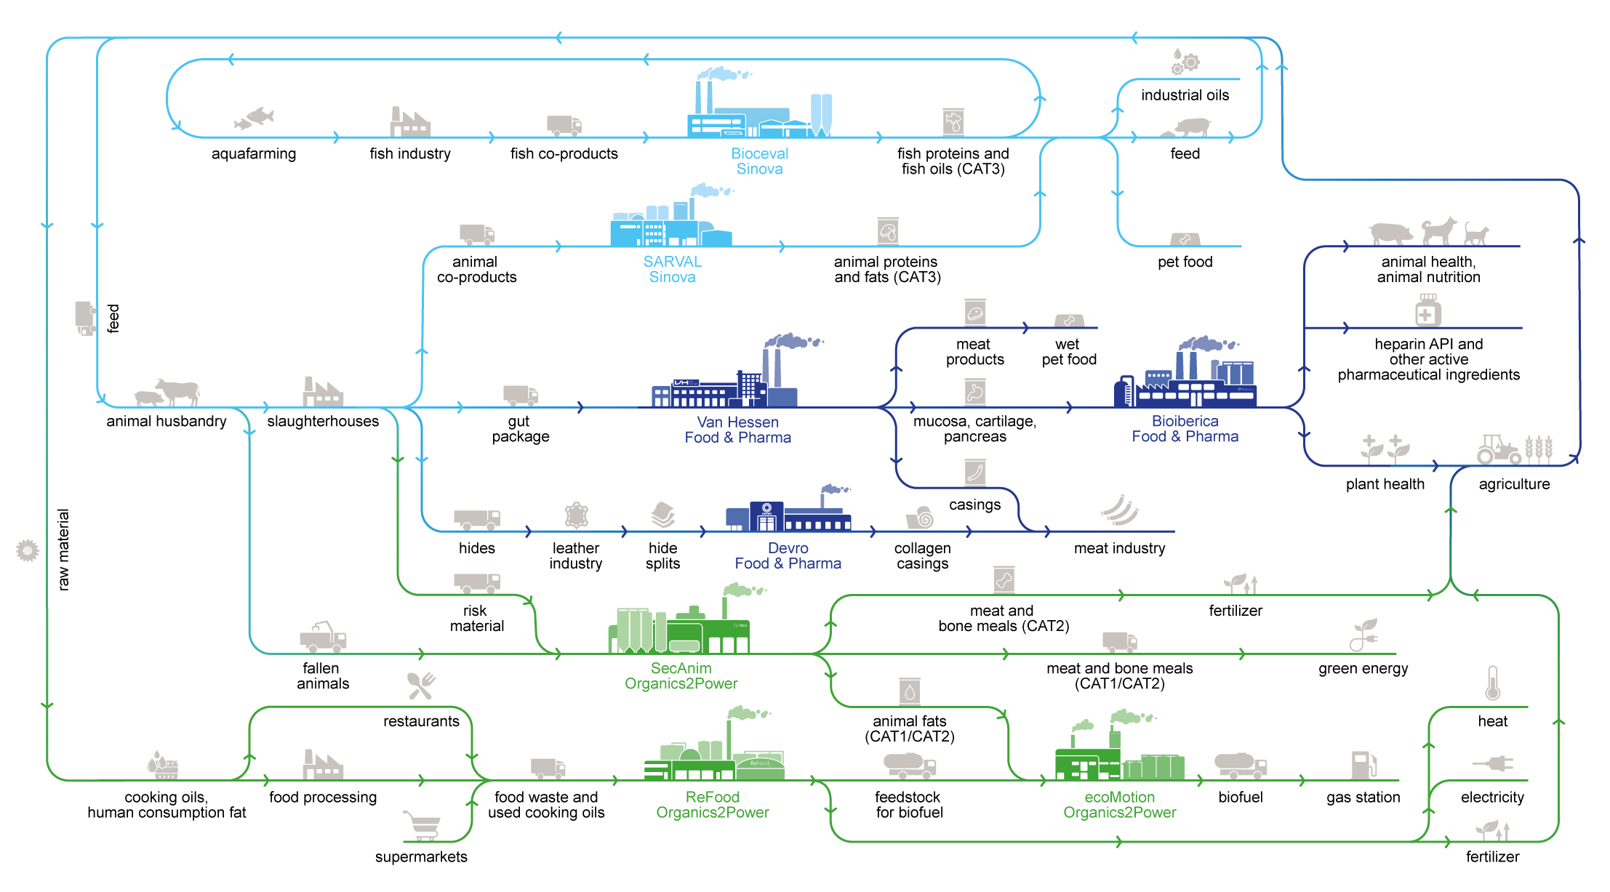
Closing the loop: SARIA’s circular business model
Our business activities and the industries we serve are all connected to each other, allowing us to create value for our partners and the environment.
Neue Version nach Umsetzung VO und Freigabe HVB

Slide 19
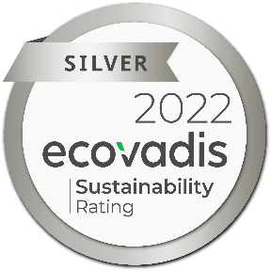
Living up to our purpose: our commitment to sustainability
We combat climate change through:
We assume social and economic responsibility:
Producing green energy for industrial and municipal use
Providing sustainable raw materials to various industries
Decarbonizing our partners’ value chain
Enabling CO₂ emission savings of up to 90%
Responsible and efficient water and energy management
As a worldwide employer of 10,500 people from all backgrounds
By continuously developing our people
Through social engagement in our local communities
With high health and safety standards and responsible business practices
Through high quality standards in our products and services

Slide 20
SARIA International GmbH
Norbert-Rethmann-Platz 1
D-59379 Selm
info@saria.de
www.saria.com
Together towards a sustainable world and healthier living

