Slide 1
Together towards a sustainable world and healthier living
Corporate Presentation

Slide 2
Diversified and multinational: key facts about SARIA
Company profile
Industries served
200+ locations worldwide
6 continents
50+ years in business
€3.7 bn revenue in 2022*
food
feed
pet food
26 countries
Selm, Germany head office
13,000 employees internationally
100% family-owned
pharma
fuel
agriculture
energy
technical
oleochemistry
*Not including Devro due to completion of transaction in 2023

Slide 3
A family business: SARIA is part of the RETHMANN Group
34%
Sustainable solutions, products and services
Recycling, services and water
All-round logistics services
Local public transport services
13,000 employees
€3.7 bn*
42,000 employees
€12.6 bn
39,000 employees
€8.6 bn
103,600 employees
€9.5 bn
Consolidated figures for FY2022 *Not including Devro due to completion of transaction in 2023

Slide 4
Our portfolio: reliable services and sustainable products
Organic fertilizer
Collagen films and coatings
Renewable energy
Natural casings
Biofuel
Heparin API
Supplements for animal health
Feed for aquaculture
Animal feed
Services for the food industry
Pet food
Services for the agricultural sector
Pharmaceutical ingredients
SARIA Corporate Video

Slide 5
Successful development: sustainable growth for many years
Continuous expansion of our portfolio through new applications, technologies and solutions
Increased specialization and upscaling in the products and services we offer
Internationalization in relevant growth markets with a global perspective
Clear customer focus and sustainability as the basis for future growth
The Group’s revenue grows to €3 bn
The Group’s revenue hits €1 bn for the first time
€180 m

Slide 6
The SARIA Framework: our purpose, vision and mission
Together towards a sustainable world and healthier living

Slide 7
Three operational divisions: the organization at a glance

Slide 8
Organics2Power: converting organic materials into green energy
SecAnim
SecAnim
SecAnim
Fallen livestock from agriculture, risk material from the meat industry
Animal meals as alternative fuel and organic fertilizers, fats as feedstock for ecoMotion biofuel
ReFood
Food waste from supermarkets, restaurants, and the food industry
Renewable energy, feedstock for ecoMotion biofuel, organic fertilizer
ecoMotion
Animal fats and used cooking oils from SecAnim and ReFood
Sustainable 2nd generation biofuel
input material(s)
output material(s)
input material(s)
output material(s)
ReFood
ecoMotion

Slide 9
Sinova: sustainable ingredients for healthy animals
SARVAL
input material(s)
Products from the meat industry that are suitable for human consumption but for which there is little demand in modern Western diets
output material(s)
input material(s)
output material(s)
Proteins, fats and oils as nutrient-rich, sustainable ingredients for the pet food, feed, aqua feed, biofuel and oleochemical industries
Bioceval
Products and species from the fish industry which are not used for human consumption

Slide 10
Food & Pharma: nutrition and health for all living organisms
Gut package and meat products from the meat industry
Natural casings, meat products, pharmaceutical raw materials supplied to Bioiberica
Van Hessen
input material(s)
output material(s)
input material(s)
output material(s)
Devro
Hide splits of bovine and porcine origin
Collagen-based casings, gels and films for the food industry
Bioiberica
Mucosa, cartilage, other products of biological origin
Heparin API and other active pharmaceutical ingredients, supplements for animal nutrition, products for plant health

Slide 11
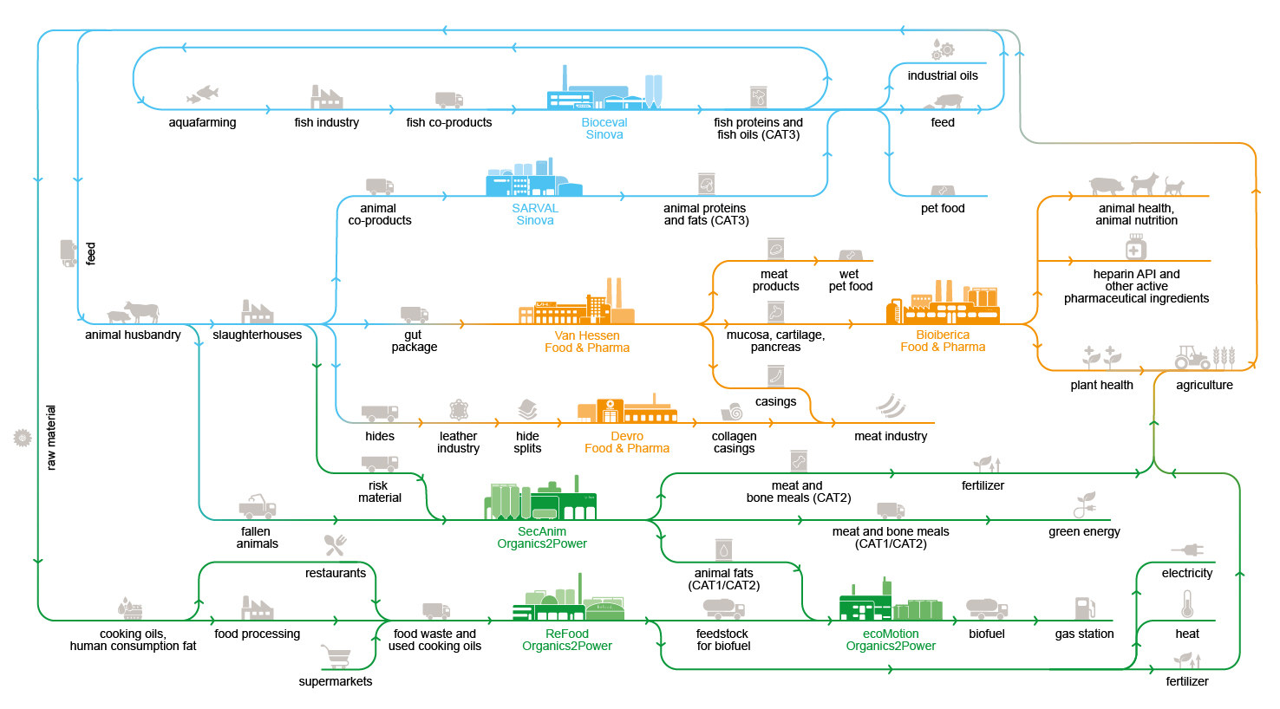
Closing the loop: SARIA’s circular business model
Our business activities and the industries we serve are all connected to each other, allowing us to create value for our partners and the environment

Slide 12
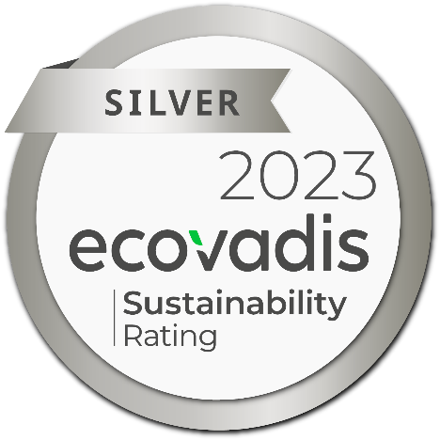
Living up to our purpose: our commitment to sustainability
We assume social and economic responsibility:
As a worldwide employer of 13,000 people from all backgrounds
By continuously developing our people
Through social engagement in our local communities
With high health and safety standards and responsible business practices
Through high quality standards in our products and services
We combat climate change through:
Producing green energy for industrial and municipal use
Providing sustainable raw materials top various industries
Decarbonizing our partners’ value chain
Enabling CO₂ emission savings of up to 90%
Responsible and efficient water and energy management

Slide 13
SARIA International GmbH
Norbert-Rethmann-Platz 1
D-59379 Selm info@saria.de
www.saria.com

